Slide 1
CS 484
Introduction to Machine Learning
Week 7, March 4, 2021
Spring Semester 2021

Slide 2
Week 7: Feature Selection
Filter Method
Wrapper Method
Embedded Method

Slide 3
Feature Selection in The Training Process
AVOID
IDENTIFY
Analytically Identify Features That May Predict The Target
SELECT
Let the Algorithm to Select Features into The Model
Subjectively Withhold Features From Consideration

Slide 4
Why Select Feature in Training Models?
Personal Identifiable Information (PII) or Protected Health Information (PHI) are prohibited from being used for any predictive models
Resources (e.g., memory, disk space, processor speed) limit the number of features that can be fed into a computer program
Weakness in algorithms or shortcomings in implementation (e.g., collinearity detection, missing values handling, and outdated platform restrictions)

Slide 5
Avoid These Features (At least, seek a second opinion before using them)
PII
Personal Identifiable Information
Any information that can be used to distinguish or trace an individual’s identity such as name, social security number, date and place of birth, mother’s maiden name, or biometric records
PHI
Protected Health Information
Any information in a medical record that can be used to identify an individual, including billing information, test results, prescription records, communication records, and scheduling records
Discriminatory
Features that challenge the state of fairness
The Equal Employment Opportunity Act (EEOA) of 1972 and the Age Discrimination in Employment Act (ADEA) of 1967
Beware of the General Data Protection Regulation (GDPR) in the European Union
Mandated by the Health Insurance Portability and Accountability Act of 1996 (HIPAA)
ADEA forbids age discrimination against people who are age 40 or older
EEOA prohibits employment discrimination based on race, color, religion, sex, or national origin

Slide 6

Feature Inclusion Directives
Certain features are included whatsoever due to business practice in an industry
U.S. regions or census tracts for data that have a geographical element
Marketing incentives in studying customer purchase behavior

Slide 7
Use These Features At Your Own Risk
Single Category
A particular category occurs too often
Relative frequency of that category is equal to or above a threshold
Constant Value
The values are within a narrow range
Coefficient of Variation (Std.Dev. / Mean) is below a threshold
Missing Value
Majority of observations are missing
Percent of missing observations is above a threshold
Many Distinct Categories
Many categories occur rarely
Relative frequencies of the majority of categories are below a threshold
May consume lot of resources
Algorithm may not anticipate
May cause machine underflow
Algorithm may not handle

Slide 8
Lack of Variety among Categories
Suppose a categorical feature has $K$ categories
Let category $j$ has $n_{j}$ number of observations, $j=1,…,K$.
If we can observe the $j^{th}$ category, then it must contain some observations. Therefore, $n_{j}>0$.
Let $\sum_{j=1}^{K}{n_{j}}=N>0$ denotes the total number of observations.
Let $p_{j}={n_{j}}/N$ denotes the empirical probability
The corresponding Entropy value is $E=−\sum_{j=1}^{K}{p_{j}\log_{2}\left(p_{j}\right)}$.

Slide 9
Lack of Variety among Categories
The maximum Entropy is $E_{max}=\log_{2}\left(K\right)$ corresponds to a boundary scenario A where all $n_{j}=N/K$.
Another boundary scenario B where $n_{1}=⋯=n_{K−1}=1$ and $n_{K}=N−K+1$. The Entropy is $E_{0}=\log_{2}\left(N\right)−\frac{N−K+1}{N}\log_{2}\left(N−K+1\right)$.
Calculate a score that is defined as ${\left(E−E_{0}\right)}/{\left(E_{max}−E_{0}\right)}$ that varies between 0 and 1, inclusively. As the general scenario is moving away from scenario B, the score will increase.
Drop a categorical feature if the score is small.

Slide 10
Seemingly Constant Interval Values
Suppose the interval feature has the mean $\overline{x}$ and the standard deviation $s$.
The Coefficient of Variation $CV=Sign\left(\overline{x}\right)×\frac{s}{max\left(1, \left|\overline{x}\right|\right)}$
$Sign\left(u\right)=1$ if $u≥0$ and $Sign\left(u\right)=−1$ if $u<0$
If the Coefficient of Variation is too small, then the values of the interval feature are likely to be constant.

Slide 11
Feature Screening
for thisVar in features:
thisDType = inputData[thisVar].dtypes
# Calculate the number and the percent of missing values
nNaN = inputData[thisVar].isna().sum()
percentNaN = 100.0 * (nNaN / nRow)
isString = numpy.NaN
entropy = numpy.NaN
percentEntropy = numpy.NaN
mean = numpy.NaN
coefVar = numpy.NaN
# Calculate the number and the percent of unique values
uniqueValue = inputData[thisVar].value_counts()
nValid = numpy.sum(uniqueValue)
uniqueProp = uniqueValue / nValid
nUnique = uniqueValue.size
if (nUnique > 0):
isString = 0
for i in range(nUnique):
if (isinstance(uniqueValue.index[i], str) == 1):
isString = 1
break

Slide 12
Feature Screening
# Calculate the entropy by treating each feature a categorical field
entropy = - numpy.sum(uniqueProp * numpy.log2(uniqueProp))
if (nUnique > 1):
e0 = nValid - nUnique + 1
e0 = numpy.log2(nValid) - (e0 / nValid) * numpy.log2(e0)
e1 = numpy.log2(nUnique)
if (e1 > e0):
percentEntropy = 100.0 * ((entropy - e0) / (e1 - e0))
# Calculate the coefficient of variation
if (isString == 0):
mean = numpy.mean(inputData[thisVar])
coefVar = numpy.std(inputData[thisVar], ddof = 1) / max(1.0, abs(mean))
if (mean < 0.0):
coefVar = - coefVar
metaData = metaData.append([[thisVar, thisDType, isString, nValid, nNaN, percentNaN, nUnique, entropy,
percentEntropy, mean, coefVar]], ignore_index=True)

Slide 13
Feature Screening
metaData = metaData.rename(columns = {0: 'Feature Field', 1: 'DType',
2: 'String Value?', 3: 'Number of Valids',
4: 'Number of NaNs', 5: 'Percent of NaNs',
6: 'Number of Unique Values', 7: 'Entropy',
8: 'Percent of Entropy',
9: 'Mean', 10: 'Coefficient of Variation'})

Slide 14
Need to Identify Helpful Features
Number of Features
From the viewpoint of a data scientist, too many features may be equally troublesome as too few features
Learner Algorithm
An algorithm is useful and effective only if it can take all the features that are specified, no matter how powerful it is
Identify the Helpful
Therefore, we need to identify the features that help predict the target accurately before specifying them in the algorithm

Slide 15
Identify the Helpful Features
Appropriate Statistical Test |  | Target Variable
 |  | Categorical | Interval
Input Feature | Categorical | Chi-square | ANOVA
 | Interval | Deviance | Regression

Slide 16
Chi-square Test
Suppose the categorical target variable $Y$ has $K>1$ categories
Suppose the categorical feature $X$ has $L>1$ categories
Let $n_{ij}≥0, i=1,…, L$ and $j=1,…,K$ be the number of observations in the $i^{th}$ category of the feature and the $j^{th}$ category of the target.
The marginal counts are:
Across Column: $n_{i+}=\sum_{j=1}^{K}{n_{ij}}$, $i=1,…, L$
Across Row: $n_{+j}=\sum_{i=1}^{L}{n_{ij}}$, $j=1,…,K$
Across Cell: $n_{++}=\sum_{i=1}^{L}{\sum_{j=1}^{K}{n_{ij}}}$

Slide 17
Chi-square Test – Poisson Distribution
We assume that the counts $n_{ij}≥0$ follow a Poisson distribution which is characterized by a single parameter$λ=E_{ij}>0$.
The probability mass function is $Pr\left(n_{ij}=x\right)=\frac{λ^{x}}{x!}e^{−λ}$, $x=0,1,…$
Under the Poisson distribution,
The expectation or the mean of $n_{ij}$ is $E\left(n_{ij}\right)=E_{ij}$ and
The variance of $n_{ij}$ is $var\left(n_{ij}\right)=E_{ij}$.

Slide 18
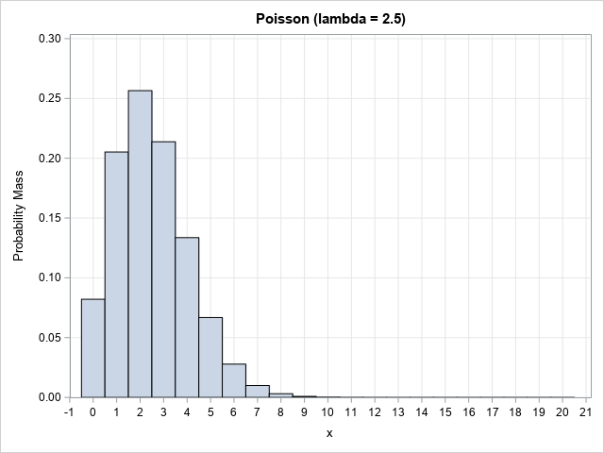
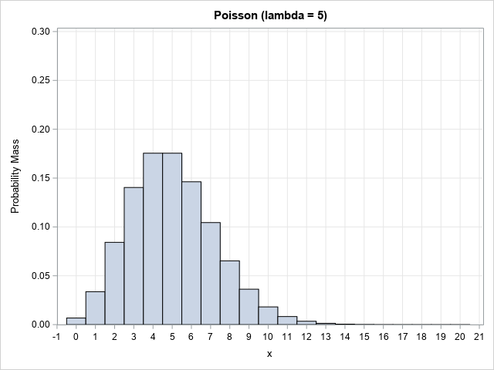
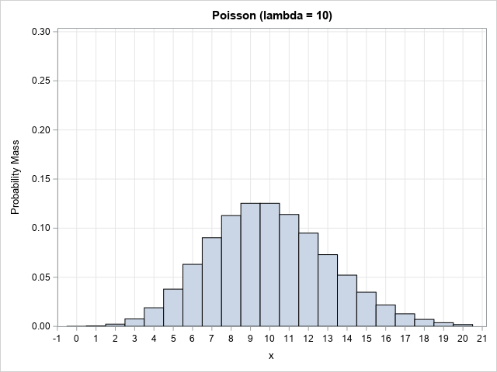
Poisson Distribution
Python Function | Density | Distribution | Significance | Quantile | Random Number
scipy.stats.poisson | .pmf() | .cdf() | .sf() | .ppf() | .rvs()

Slide 19
Chi-square Test
The normalized term $\frac{n_{ij}−E_{ij}}{\sqrt{E_{ij}}}$ asymptotically follows a standard normal distribution when $n_{ij}$ is large.
In other words, $\frac{{\left(n_{ij}−E_{ij}\right)}^{2}}{E_{ij}}$ asymptotically follows a Chi-square distribution with one degree of freedom.
What is the distribution of $\sum_{i=1}^{L}{\sum_{j=1}^{K}{\frac{{\left(n_{ij}−E_{ij}\right)}^{2}}{E_{ij}}}}$?

Slide 20
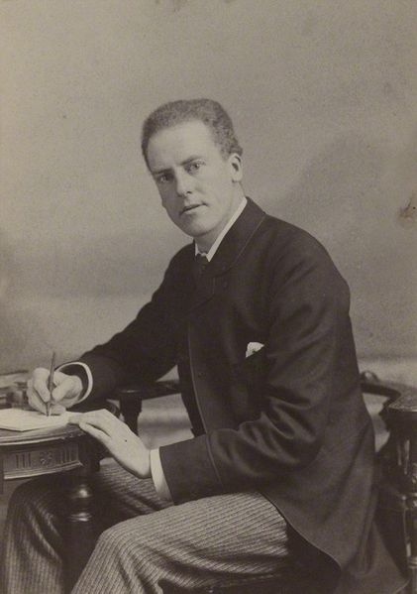
Chi-square Test
Karl Pearson (1857 – 1936), an English mathematician and biostatistician, proved that $\sum_{i=1}^{L}{\sum_{j=1}^{K}{\frac{{\left(n_{ij}−E_{ij}\right)}^{2}}{E_{ij}}}}$ follows a Chi-Square distribution with positive degrees of freedom asymptotically.
The degrees of freedom depends on how the $E_{ij}$ are computed.

Slide 21
Chi-Square Distribution
Let $V$ be a continuous random variable that takes values from this open interval $(0,∞)$.
The probability density function is $f\left(v\right)=\frac{1}{2^{m/2}Γ\left(m/2\right)}v^{\frac{m}{2} −1}e^{−\frac{v}{2}}$
$m>0$ is the degrees of freedom
$Γ\left(u\right)$ is the complete Gamma function
The probability $Pr\left(V<v\right)=\int_{0}^{v}{f\left(u\right) du}$ (i.e., no closed-form).
The mean is $m$ and the variance is $2m$.
When $m=2$, the Chi-square distribution is an Exponential distribution with $λ=1/2$.

Slide 22
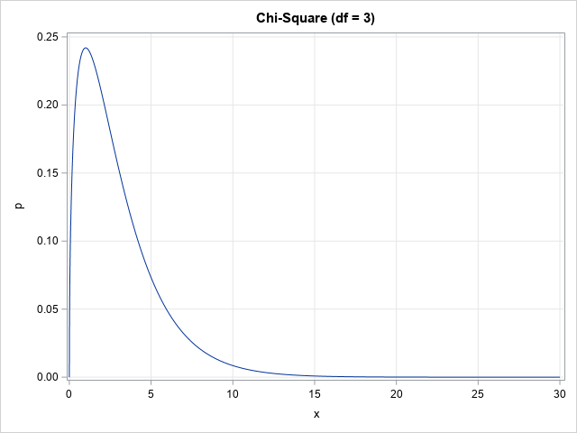
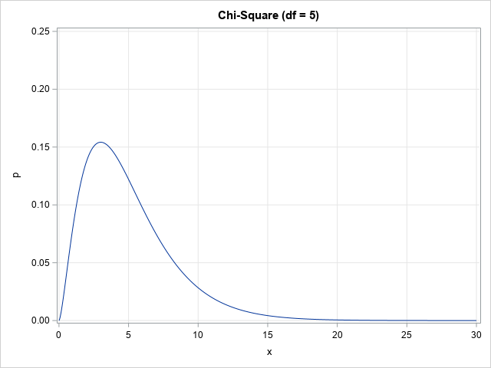
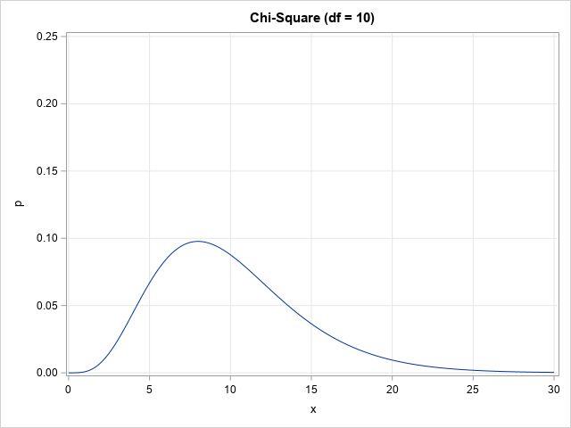
Chi-Square Distribution
Python Function | Density | Distribution | Significance | Quantile | Random Number
scipy.stats.chi2 | .pdf() | .cdf() | .sf() | .ppf() | .rvs()

Slide 23
Chi-square Test – Expected Count
Feature | Target
 | No | Yes | Total
A | 4 | 6 | 10
B | 2 | 3 | 5
C | 8 | 12 | 20
Total | 14 | 21 | 35
IF the feature is statistically independent of the target variable, then the feature will not help predict the target variable
THEN the relative frequencies (or percentages) across the target categories are the same for each feature’s category
THEREFORE, the common relative frequencies are be estimated by ${n_{+j}}/{n_{++}},j=1,…,K$
THEREFORE, the common relative frequencies are be estimated by 𝑛_(+𝑗)∕𝑛_(++) ,𝑗=1,…,𝐾
HENCE, the expected count in the $\left(i,j\right)$ cell is $E_{ij}=n_{i+}\frac{n_{+j}}{n_{++}}$
HENCE, the expected count in the (𝑖,𝑗) cell is 𝐸_𝑖𝑗=𝑛_(𝑖+) 𝑛_(+𝑗)/𝑛_(++)
Feature | Target
 | No | Yes | Total
A | 0.4 | 0.6 | 1
B | 0.4 | 0.6 | 1
C | 0.4 | 0.6 | 1
Total | 0.4 | 0.6 | 1

Slide 24
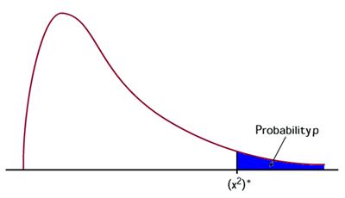
Chi-square Test - Procedure
The expected count in the $\left(i,j\right)$ cell is $E_{ij}=n_{i+}\frac{n_{+j}}{n_{++}}>0$
The Pearson Chi-square statistic is $χ^{2}=\sum_{i=1}^{L}{\sum_{j=1}^{K}{\frac{{\left(n_{ij}−E_{ij}\right)}^{2}}{E_{ij}}}}$
The one-sided significance (the probability on the right tail) from the Chi-square distribution with $\left(L−1\right)\left(K−1\right)$ degrees of freedom
Reject the Independence Assumption if the significance value is less than α, say 0.05, and identify this feature as useful

Slide 25
Chi-square Test - Procedure
# Define a function that performs the Pearson Chi-square test
# xCat - Input categorical feature (array-like or Series)
# yCat - Input categorical target field (array-like or Series)
def PearsonChiSquareTest (xCat, yCat):
# Generate the crosstabulation
obsCount = pandas.crosstab(index = xCat, columns = yCat, margins = False, dropna = True)
xNCat = obsCount.shape[0]
yNCat = obsCount.shape[1]
cTotal = obsCount.sum(axis = 1)
rTotal = obsCount.sum(axis = 0)
nTotal = numpy.sum(rTotal)
expCount = numpy.outer(cTotal, (rTotal / nTotal))
# Calculate the Chi-Square statistics
chiSqStat = ((obsCount - expCount)**2 / expCount).to_numpy().sum()
chiSqDf = (xNCat - 1) * (yNCat - 1)
if (chiSqDf > 0):
chiSqSig = sdist.chi2.sf(chiSqStat, chiSqDf)
else:
chiSqSig = numpy.NaN
return (xNCat, yNCat, chiSqStat, chiSqDf, chiSqSig)

Slide 26
Analysis of Variance (ANOVA) Test
Suppose the categorical feature $X$ has $L>1$ categories
Suppose the interval target is $Y$.
Let $y_{ij}, j=1,…, n_{i}$ and $i=1,…, L$be the observations in the $i^{th}$ category of the feature.
Let ${\overline{y}}_{i}=\frac{1}{n_{i}}\sum_{j=1}^{n_{i}}{y_{ij}}$ be the target’s mean in the $i^{th}$ category of the feature.
Let $\overline{y}=\frac{\sum_{i=1}^{L}{\sum_{j=1}^{n_{i}}{y_{ij}}}}{\sum_{i=1}^{L}{n_{i}}}$ be the target’s overall mean.

Slide 27
Analysis of Variance (ANOVA) Test
Within-Group
Sum of Squares $SSW=\sum_{i=1}^{L}{\sum_{j=1}^{n_{i}}{{\left(y_{ij}−{\overline{y}}_{i}\right)}^{2}}}$
Degrees of Freedom $DFW=\sum_{i=1}^{L}{\left(n_{i}−1\right)}$.
Total
Sum of Squares $SST=\sum_{i=1}^{L}{\sum_{j=1}^{n_{i}}{{\left(y_{ij}−\overline{y}\right)}^{2}}}$
Degrees of Freedom $DFT=\sum_{i=1}^{L}{n_{i}−1}$.
Between-Group
Sum of Squares $SSG=SST−SSW$
Degrees of Freedom $DFG=DFT−DFW=L−1$.

Slide 28
Analysis of Variance (ANOVA) Test
IF the feature is statistically independent of the target variable, then the feature will not help predict the target variable
THEN the target has the same mean across all feature’s categories
THEREFORE, both ${SSG}/{DFG}$ and ${SSW}/{DFW}$ both estimate the population variance.
THEREFORE, both 𝑆𝑆𝐺∕𝐷𝐹𝐺 and 𝑆𝑆𝑊∕𝐷𝐹𝑊 both estimate the population variance.
HENCE, the ratio $F=\frac{{SSG}/{DFG}}{{SSW}/{DFW}}$ follows a F distribution
HENCE, the ratio 𝐹=(𝑆𝑆𝐺∕𝐷𝐹𝐺)/(𝑆𝑆𝑊∕𝐷𝐹𝑊) follows a F distribution

Slide 29
Continuous – F Distribution
The probability density function is
$$f\left(x\right)=\frac{Γ\left({\left(ν_{1}+ν_{2}\right)}/2\right)}{Γ\left({ν_{1}}/2\right)Γ\left({ν_{2}}/2\right)}{\left(\frac{ν_{1}}{ν_{2}}\right)}^{\frac{ν_{1}}{2}}x^{\frac{ν_{1}}{2}−1}{\left(1+\frac{ν_{1}}{ν_{2}}x\right)}^{−\frac{ν_{1}+ν_{2}}{2}}$$
The domain is $0<x<∞$.
$ν_{1}>0$ is the first (numerator) degrees of freedom
$ν_{2}>0$ is the second (denominator) degrees of freedom
$Γ\left(a\right)=\int_{0}^{∞}{t^{a−1}e^{−t}dt}$, $a>0$ is the complete Gamma function
The mean is $\frac{ν_{2}}{\left(ν_{2}−2\right)}$ and the variance is $\frac{2ν_{2}^{2}\left(ν_{1}+ν_{2}−2\right)}{ν_{1}{\left(ν_{2}−2\right)}^{2}\left(ν_{2}−4\right)}$.

Slide 30
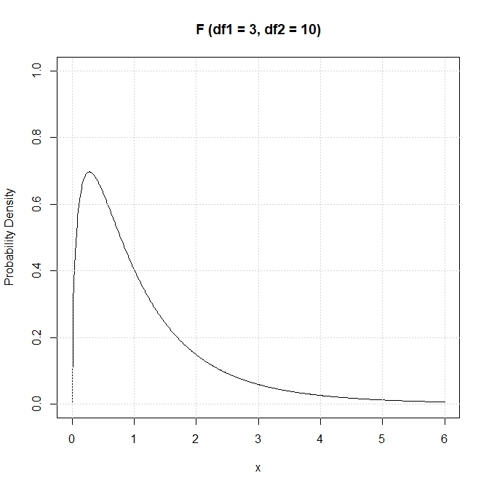
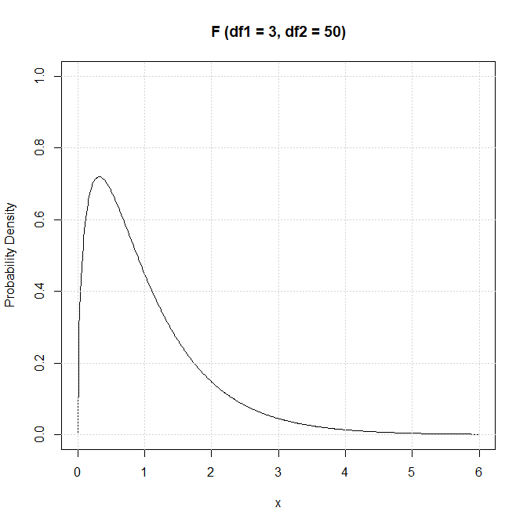
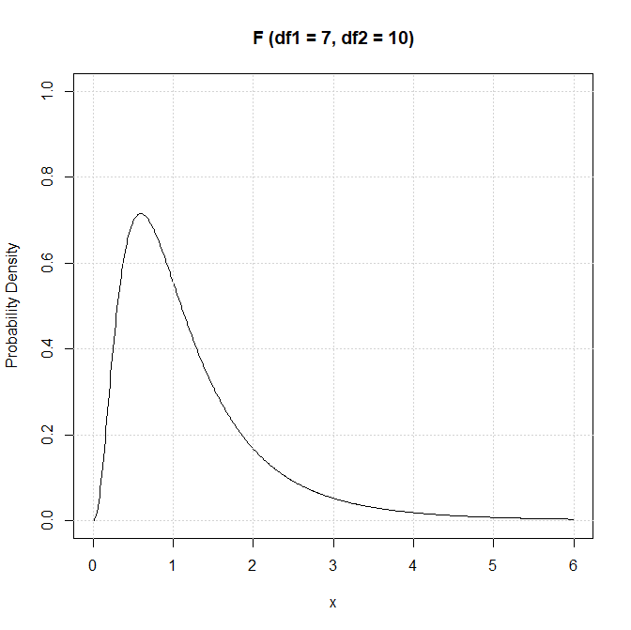
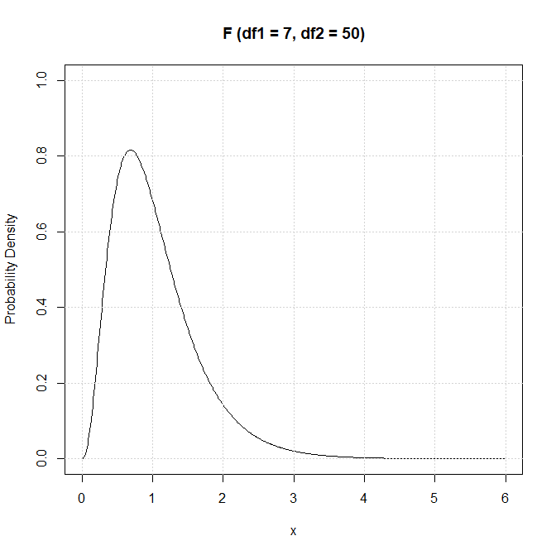
Continuous – F Distribution
Python Function | scipy.stats.f
Density | .pdf()
Distribution | .cdf()
Significance | .sf()
Quantile | .ppf()
Random Number | .rvs()

Slide 31
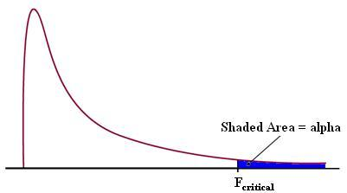
F Test - Procedure
The SSG, the DFG, the SSW, and the DFW
The statistic $F=\frac{{SSG}/{DFG}}{{SSW}/{DFW}}$
The one-sided significance (the probability on the right tail) from the F distribution with dfn = $DFG$ and dfd = $DFW$ degrees of freedom
Reject the Independence Assumption if the significance value is less than α, say 0.05, and identify this feature as useful

Slide 32
F Test - Procedure
# Define a function that performs the ANOVA test
# xCat - Input categorical feature (array-like or Series)
# yCont - Input continuous target field (array-like or Series)
def AnalysisOfVarianceTest (xCat, yCont):
df = pandas.DataFrame(columns = ['x', 'y'])
df['x'] = xCat
df['y'] = yCont
# Total Count and Sum of Squares
totalCount = df['y'].count()
totalSSQ = df['y'].var(ddof = 0) * totalCount
# Within Group Count and Sums of Squares
groupCount = df.groupby('x').count()
groupSSQ = df.groupby('x').var(ddof = 0) * groupCount
nGroup = groupCount.shape[0]
withinSSQ = numpy.sum(groupSSQ.values)
betweenSSQ = max(0.0, (totalSSQ - withinSSQ))
# Compute F statistics
fDf1 = (nGroup - 1)
fDf2 = (totalCount - nGroup)
if (fDf1 > 0 and fDf2 > 0 and withinSSQ > 0.0):
fStat = (betweenSSQ / fDf1) / (withinSSQ / fDf2)
fSig = sdist.f.sf(fStat, fDf1, fDf2)
else:
fStat = numpy.NaN
fSig = numpy.NaN
xNCat = nGroup
return (xNCat, fStat, fDf1, fDf2, fSig)

Slide 33
Regression Test
Suppose $\left(x_{i}, y_{i}\right), i=1,…,n$ are the pairs of values for the feature $X$ and the target variable $Y$.
Let $\overline{x}=\frac{1}{n}\sum_{i=1}^{n}{x_{i}}$ be the mean of the feature
Let $\overline{y}=\frac{1}{n}\sum_{i=1}^{n}{y_{i}}$ be the mean of the target variable
If we fit this regression line $y=α+βx$, the regression coefficient is $\hat{β}=\frac{\sum_{i=1}^{n}{\left(x_{i}−\overline{x}\right)\left(y_{i}−\overline{y}\right)}}{\sum_{i=1}^{n}{{\left(x_{i}−\overline{x}\right)}^{2}}}$ and the intercept is $\hat{α}=\overline{y}−\hat{β}\overline{x}$.
The fitted values are ${\hat{y}}_{i}=\hat{α}+\hat{β}x_{i},i=1,…,n$.

Slide 34
Regression Test
The residual sum of squares is $RSS=\sum_{i=1}^{n}{{\left(y_{i}−{\hat{y}}_{i}\right)}^{2}}$.
The estimated residual variance is $\hat{σ^{2}}=\frac{\sum_{i=1}^{n}{{\left(y_{i}−{\hat{y}}_{i}\right)}^{2}}}{n−2}$
The standard error of $\hat{β}$is $se\left(\hat{β}\right)=\sqrt{\frac{\hat{σ^{2}}}{\sum_{i=1}^{n}{{\left(x_{i}−\overline{x}\right)}^{2}}}}$.
The statistic $t=\frac{\hat{β}}{se\left(\hat{β}\right)}$ follows a Student’s t distribution with $n−2$ degrees of freedom.

Slide 35
Continuous – Student’s t Distribution
Let $X$ be a continuous random variable that takes values from this open interval $(−∞,∞)$.
The probability density function is $f\left(x\right)=\frac{Γ\left(\frac{k+1}{2}\right)}{\sqrt{kπ} Γ\left(\frac{k}{2}\right)}{\left(1+\frac{x^{2}}{k}\right)}^{−\frac{k+1}{2}}$
$k>0$ is the degrees of freedom
$Γ\left(u\right)$ is the complete Gamma function
The probability $Pr\left(X<x\right)=\int_{0}^{x}{f\left(u\right) du}$ (i.e., no closed-form).
The mean is $0$ and the variance is $k/{\left(k−2\right)}$.
The variance does not exist if $k≤2$.

Slide 36
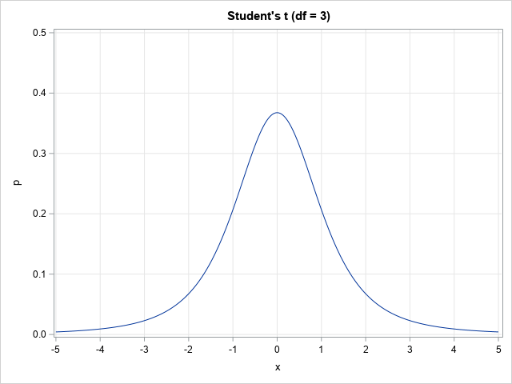
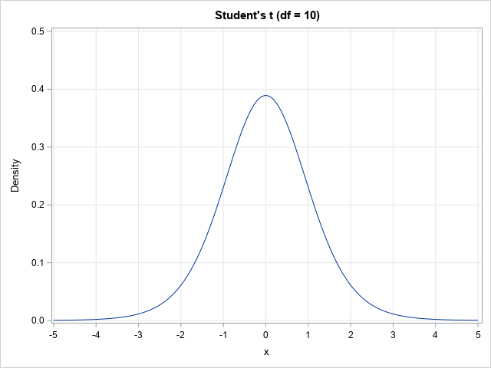
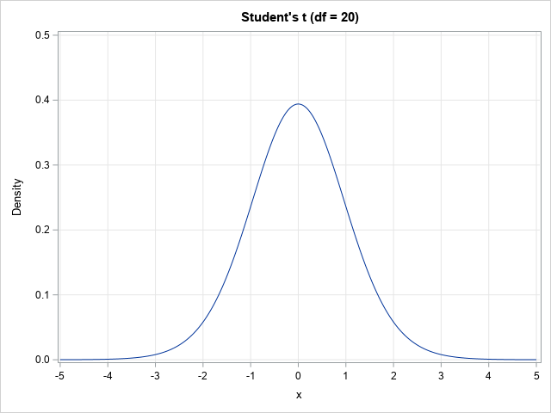
Continuous – Student’s t Distribution
Python Function | Density | Distribution | Significance | Quantile | Random Number
scipy.stats.t | .pdf() | .cdf() | .sf() | .ppf() | .rvs()

Slide 37
Regression Test
IF the feature is statistically independent of the target variable, then the feature will not help predict the target variable
THEN the regression coefficient $β$ is zero
THEN the regression coefficient 𝛽 is zero
THEREFORE, the absolute value of statistic $t=\frac{\hat{β}}{se\left(\hat{β}\right)}$ should be small.
THEREFORE, the absolute value of statistic 𝑡=𝛽 ̂/se(𝛽 ̂ ) should be small.

Slide 38
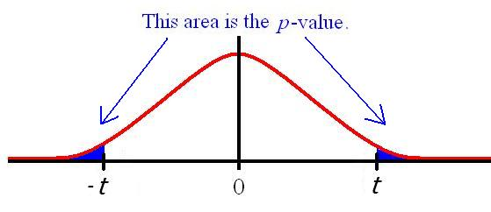
Student’s t Test - Procedure
The regression coefficient $\hat{β}$ and its standard error $se\left(\hat{β}\right)$
The statistic $t={\hat{β}}/{se\left(\hat{β}\right)}$
The two-sided significance (the probability on both tails) from the Student’s t distribution with $n−2$ degrees of freedom
Reject the Independence Assumption if the significance value is less than α, say 0.05, and identify this feature as useful

Slide 39
Student’s t Test - Procedure
# Define a function that performs the Regression test
# xCont - Input continuous feature (array-like or Series)
# yCont - Input continuous target field (array-like or Series)
def RegressionTest (xCont, yCont):
nObs = len(yCont)
xyCov = numpy.cov(xCont, yCont, ddof = 0)
tDf = nObs - 2
tStat = numpy.NaN
tSig = numpy.NaN
if (tDf > 0 and xyCov[0,0] > 0.0):
xMean = numpy.mean(xCont)
yMean = numpy.mean(yCont)
regB = xyCov[0,1] / xyCov[0,0]
yHat = yMean + regB * (xCont - xMean)
residVariance = numpy.sum((yCont - yHat)**2) / tDf
if (residVariance > 0.0):
seB = numpy.sqrt(residVariance / (nObs * xyCov[0,0]))
tStat = regB / seB
tSig = 2.0 * sdist.t.sf(abs(tStat), tDf)
return (tStat, tDf, tSig)

Slide 40
Deviance Test
Suppose the interval feature is $X$
Suppose the categorical target variable $Y$ has $K>1$ categories
IF the feature is statistically independent of the target variable, then the feature will not help predict the target variable
THEN the goodness-of-fit of a logistic model with the interval feature $X$ should be the same as another logistic model without the interval feature is $X$
THEN the goodness-of-fit of a logistic model with the interval feature 𝑋 should be the same as another logistic model without the interval feature is 𝑋
THEREFORE, the Deviance statistic should be small

Slide 41
Deviance Test - Procedure
Build a multinomial logistic model with only the Intercept term. Let $l_{0}$ be the model log-likelihood value.
Build another multinomial logistic model with the Intercept term and the interval feature $X$. Let $l_{1}$ be the model log-likelihood value.
Calculate this statistic $G^{2}=2\left(l_{1}−l_{0}\right)$
The one-sided significance (the probability on right tail) from the Chi-square distribution with $K−1$ degrees of freedom
Reject the Independence Assumption if the significance value is less than α, say 0.05, and identify this feature as useful

Slide 42
Deviance Test - Procedure
# Define a function that performs the Deviance Chi-square test
# xCont - Input categorical feature (array-like or Series)
# yCat - Input categorical target field (array-like or Series)
def DevianceTest (xCont, yCat):
# Train a model with the Intercept term and xCont
X = smodel.add_constant(xCont, prepend = True)
y = yCat.astype('category')
logit = smodel.MNLogit(y, X)
yNCat = logit.J
thisFit = logit.fit(method = 'newton', maxiter = 1000, full_output = False, disp = False)
chiSqStat = thisFit.llr
chiSqDf = thisFit.df_model
chiSqSig = thisFit.llr_pvalue
return (yNCat, chiSqStat, chiSqDf, chiSqSig)

Slide 43
The Home Equity Loan Example
Categorical Feature: REASON, JOB, DEROG, DELINQ, and NINQ
Interval Feature: LOAN, MORTDUE, VALUE, YOJ, CLAGE, CLNO, and DEBTINC
5,960 records, 13 variables read from hmeq.csv
3,364 complete records analyzed
Chi-square Test for categorical features
Deviance Test for Interval Feature
Categorical Target Variable: BAD
Ranking based on Significance

Slide 44
The Home Equity Loan Example
Week 7 Identify Useful Feature for Cat Target.py
# The Home Equity Loan example
catPred = ['REASON', 'JOB', 'DEROG', 'DELINQ', 'NINQ']
intPred = ['LOAN', 'MORTDUE', 'VALUE', 'YOJ', 'CLAGE', 'CLNO', 'DEBTINC']
hmeq = pandas.read_csv('C:\\IIT\\Machine Learning\\Data\\hmeq.csv',
delimiter=',', usecols = ['BAD']+catPred+intPred)
hmeq = hmeq.dropna()
testResult = pandas.DataFrame()
for pred in catPred:
xNCat, yNCat, chiSqStat, chiSqDf, chiSqSig = PearsonChiSquareTest(hmeq[pred], hmeq['BAD'])
testResult = testResult.append([[pred, xNCat, yNCat, chiSqStat, chiSqDf, chiSqSig]], ignore_index = True)
for pred in intPred:
yNCat, chiSqStat, chiSqDf, chiSqSig = DevianceTest(hmeq[pred], hmeq['BAD'])
testResult = testResult.append([[pred, numpy.NaN, yNCat, chiSqStat, chiSqDf, chiSqSig]], ignore_index = True)
testResult = testResult.rename(columns = {0:’Feature', 1: 'Feature N Category', 2: 'Target N Category',
3:'Statistic', 4:'DF', 5:'Significance'})
rankSig = testResult.sort_values('Significance', axis = 0, ascending = True)

Slide 45
The Home Equity Loan Example
Type | Feature | Feature N Category | Target N Category | Statistic | DF | Significance
Categorical | REASON | 2 | 2 | 0.1313 | 1 | 0.7171
 | JOB | 6 | 2 | 36.2547 | 5 | 8.4465E-07
 | DEROG | 11 | 2 | 237.8857 | 10 | 1.9039E-45
 | DELINQ | 10 | 2 | 302.7278 | 9 | 6.8868E-60
 | NINQ | 13 | 2 | 97.5806 | 12 | 1.6558E-15
Interval | LOAN |  | 2 | 3.5111 | 1 | 0.0610
 | MORTDUE |  | 2 | 0.9512 | 1 | 0.3294
 | VALUE |  | 2 | 2.4398 | 1 | 0.1183
 | YOJ |  | 2 | 14.8204 | 1 | 0.0001
 | CLAGE |  | 2 | 50.6898 | 1 | 1.0818E-12
 | CLNO |  | 2 | 0.1896 | 1 | 0.6632
 | DEBTINC |  | 2 | 144.4416 | 1 | 2.8447E-33

Slide 46
The Home Equity Loan Example
Using the tolerance level $α=0.05$, seven features (shown on the right) are identified as helpful in predicting the categorical target BAD
Categorical
DELINQ
Interval
DEBTINC
DEROG
NINQ
JOB
YOJ
CLAGE

Slide 47

Feature Importance
In the previous example, the significances of seven features are less than 0.05.
Among them:
DELINQ has the smallest significance at 6.89E-60
YOJ has the largest significance at 0.0001
Do these significances carry the same weights in our decision?
Do these significances indicate that some features are more important than others?

Slide 48
Common Measures for Feature Importance
Significance
Rank significances on the logarithm scale
Suppose the significance of a statistical test is $0<p≤1$, then calculate importance as $−\log_{10}\left(p\right)$.
Suppose the significance of a statistical test is 0<𝑝≤1, then calculate importance as −log_10⁡(𝑝).
Association
Measure the strength of association
The higher the importance value, the more predictive a feature for the target variable.
Calculate the appropriate statistic for measuring the strength of association between the feature and the target variable.

Slide 49
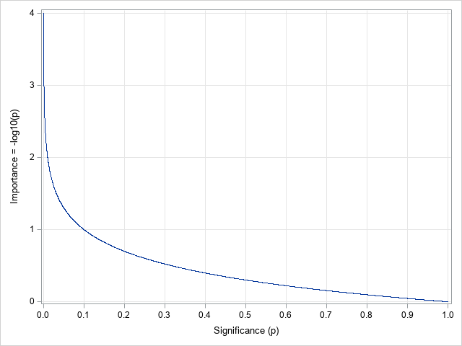
Feature Importance: $−\log_{10}\left(Significance\right)$
Suppose the significance of a statistical test is $0<p≤1$, then calculate importance as $−\log_{10}\left(p\right)$.
If $p=1$, then the importance measure is zero
If $p$ is zero because the significance value falls below the machine precision, then we define the importance measure as infinity
The higher the importance value, the more predictive a feature for the target variable.
Note: The machine precision is $2^{−52}$ for the 64-bit floating point arithmetic
Python: numpy.finfo(float).eps

Slide 50
The Home Equity Loan Example
Feature | Feature N Category | Target N Category | Statistic | DF | Significance | -log10(Significance)
DELINQ | 10 | 2 | 302.7278 | 9 | 6.8868E-60 | 59.2
DEROG | 11 | 2 | 237.8857 | 10 | 1.9039E-45 | 44.7
DEBTINC |  | 2 | 144.4416 | 1 | 2.8447E-33 | 32.5
NINQ | 13 | 2 | 97.5806 | 12 | 1.6558E-15 | 14.8
CLAGE |  | 2 | 50.6898 | 1 | 1.0818E-12 | 12.0
JOB | 6 | 2 | 36.2547 | 5 | 8.4465E-07 | 6.1
YOJ |  | 2 | 14.8204 | 1 | 0.0001 | 3.9
LOAN |  | 2 | 3.5111 | 1 | 0.0610 | 1.2
VALUE |  | 2 | 2.4398 | 1 | 0.1183 | 0.9
MORTDUE |  | 2 | 0.9512 | 1 | 0.3294 | 0.5
CLNO |  | 2 | 0.1896 | 1 | 0.6632 | 0.2
REASON | 2 | 2 | 0.1313 | 1 | 0.7171 | 0.1
Week 7 Identify Useful Feature for Cat Target.py

Slide 51
Association Based Feature Importance
We prefer the association-based importance measure to be:
Positive
Between zero and one
A higher value indicates more important, and a lower value indicates less important
Appropriate Association Measure |  | Target Variable
 |  | Categorical | Interval
Input Feature | Categorical | Cramer’s V | Eta-squared
 | Interval | McFadden's Pseudo R^2 | Squared Pearson Correlation

Slide 52
Cramer’s V
Suppose the categorical target variable $Y$ has $K>1$ categories
Suppose the categorical feature $X$ has $L>1$ categories
Let $n_{ij}≥0, i=1,…, L$ and $j=1,…,K$ be the number of observations in the $i^{th}$ category of the feature and the $j^{th}$ category of the target.
The marginal counts are:
Across Column: $n_{i+}=\sum_{j=1}^{K}{n_{ij}}$, $i=1,…, L$
Across Row: $n_{+j}=\sum_{i=1}^{L}{n_{ij}}$, $j=1,…,K$
Across Cell: $n_{++}=\sum_{i=1}^{L}{\sum_{j=1}^{K}{n_{ij}}}$

Slide 53
Cramer’s V
The expected count in the $\left(i,j\right)$ cell is $E_{ij}=n_{i+}\frac{n_{+j}}{n_{++}}>0$
The Pearson Chi-square statistic is $χ^{2}=\sum_{i=1}^{L}{\sum_{j=1}^{K}{\frac{{\left(n_{ij}−E_{ij}\right)}^{2}}{E_{ij}}}}$
The Cramer’s V is $V=\sqrt{\frac{χ^{2}}{n_{++} × min\left(K−1, L−1\right)}}$
The Cramer’s V is between 0 and 1
A larger Cramer’s V indicates that a particular category in the feature is associated with a particular category in the target variable

Slide 54
Eta-squared
Within-Group Sum of Squares $SSW=\sum_{i=1}^{L}{\sum_{j=1}^{n_{i}}{{\left(y_{ij}−{\overline{y}}_{i}\right)}^{2}}}$
Total Sum of Squares $SST=\sum_{i=1}^{L}{\sum_{j=1}^{n_{i}}{{\left(y_{ij}−\overline{y}\right)}^{2}}}$
Between-Group Sum of Squares $SSG=SST−SSW$
The Eta-squared is $η^{2}=\frac{SSG}{SST}$
The Eta-squared is between 0 and 1
A larger $η^{2}$indicates that the means of the target variable in the feature’s categories are different.

Slide 55
Squared Pearson Correlation
Suppose $\left(x_{i}, y_{i}\right), i=1,…,n$ are the pairs of values for the feature $X$ and the target variable $Y$.
Let $\overline{x}=\frac{1}{n}\sum_{i=1}^{n}{x_{i}}$ be the mean of the feature
Let $\overline{y}=\frac{1}{n}\sum_{i=1}^{n}{y_{i}}$ be the mean of the target variable
The squared Pearson correlation is $r^{2}=\frac{{\left(\sum_{i=1}^{n}{\left(x_{i}−\overline{x}\right)\left(y_{i}−\overline{y}\right)}\right)}^{2}}{\left(\sum_{i=1}^{n}{{\left(x_{i}−\overline{x}\right)}^{2}}\right)\left(\sum_{i=1}^{n}{{\left(y_{i}−\overline{y}\right)}^{2}}\right)}$
The squared Pearson correlation is between 0 and 1
A larger $r^{2}$ indicates that the larger-than-mean feature values are associated with larger (or smaller)-than-mean target values

Slide 56
McFadden's Pseudo R^2
Build a multinomial logistic model with only the Intercept term. Let $l_{0}$ be the model log-likelihood value.
Build another multinomial logistic model with the Intercept term and the interval feature $X$. Let $l_{1}$ be the model log-likelihood value.
The McFadden’s Pseudo R-squared is $R_{McF}^{2}=1−\frac{l_{1}}{l_{0}}$
The McFadden’s Pseudo R-squared is between 0 and 1
If the interval feature does not help predict the categorical target, then $l_{1}=l_{0}$ and $R_{McF}^{2}=0$.
If the interval feature completely predicts the categorical target (i.e., complete separation), then $l_{1}=0$ and $R_{McF}^{2}=1$.

Slide 57
Remarks on Feature Importance
Significance-based metric depends on the statistical power of the test in rejecting the Independence Assumption
Association-based metric may have different interpretation between categorical and interval features

Slide 58
Wrapper Method
This method selects features by using the model assessment metrics, e.g., sum of squared residuals, or log-likelihood value
Determine a subset of features that generates the optimal metrics.
Exhaustive Search – All Possible Subset
Directional Search – Forward / Backward Selection
Random Search – Generate a Random Subset of Features
Consider using the AIC or the BIC values to balance our desire for optimal metrics and the need for a model with fewer parameters.

Slide 59
Embedded Method
The Embedded method is built into a machine learning algorithm.
There are primarily two approaches in the Embedded method.
The first approach manipulates the model parameter estimates to either boost or diminish a feature’s influence on the predicted target values.
The second approach provides us feature importance indices.

Slide 60
First Approach of Embedded Method
The first approach manipulates the model parameter estimates to either boost or diminish a feature’s influence on the predicted target values.
This approach is available only to machine learning algorithms that train parametric models.
The Regularization method is a common representative of the first approach.

Slide 61
Second Approach of Embedded Method
The second approach lets a machine learning algorithm runs its course, but it will train the model under simulated scenarios.
This approach collects model information under simulated sceanios to evaluate the effectiveness of a feature in predicting the model outcomes.
The evaluation results are then compiled to give us the feature importance indices.
The tree-based random forest method is a common representative of the second approach.

Slide 62
In the Interest of Time …
In the interest of time, we will focus only on the Regularization method.
Besides, we are more interested in training a model with just the right number of features than knowing their relative importance.

Slide 63
Regularization Method
Denote the parameters as $β^{t}=\left(β_{1},…,β_{p}\right)$, the objective function as $l\left(β\right)$, and the penalty term as $T\left(β\right)≥0$.
The Regularization method will minimize $C×l\left(β\right)+T\left(β\right)$ with respect to $β∈Ω$ where $Ω$ is a domain space for the parameters. Often, $Ω=ℝ^{p}$ the $p$-dimension real number space.
The $C>0$ multiplier specifies the relative regularization strength.
Values less than one, i.e., $0<C<1$, specify stronger regularization.
Values greater than one, i.e., $C>1$ specify weaker regularization.
When $C=1$, then both the objective function and the penalty term contribute equally to the optimization.

Slide 64
L1 Regularization
Penalty term is $T\left(β\right)=\sum_{j=1}^{p}{\left|β_{j}\right|}$.
Also known as LASSO Regression (LASSO stands for Least Absolute Shrinkage and Selection Operator).
This penalty is applied linearly to all magnitudes of parameters.
The penalty will force the parameters of the unselected features down to zero but tolerate the selected feature to have justifiable larger parameter values.

Slide 65
L2 Regularization
Penalty term is $T\left(β\right)=\sum_{j=1}^{p}{β_{j}^{2}}$.
Also known as Ridge Regression.
This penalty aggressively persuades all features to avoid large parameter values, period. Otherwise, the penalty is quadratically increases.
On the contrary, it does not force the unselected features’ parameters to zero only if these features keep their parameter values at bay (i.e., small enough without increasing the penalty substantially).

Slide 66
L1/L2 Regularization
Penalty Term is $T\left(β\right)=φ\sum_{j=1}^{p}{\left|β_{j}\right|}+\left(1−φ\right)\sum_{j=1}^{p}{β_{j}^{2}}$ where $0≤φ≤1$.
Also known as Elastic Nets.
This penalty is a combination of the L1 Regularization and the L2 Regularization.
We can adjust the $φ$ value to take advantage of the merits of both regularizations and to downplay their drawbacks.

Slide 67
Regularization on Logistic Regression
import sklearn.linear_model as linear_model
import sklearn.metrics as metrics
import statsmodels.api as smodel
# The Home Equity Loan example
catTarget = 'BAD'
intPred = ['LOAN', 'MORTDUE', 'VALUE', 'YOJ', 'CLAGE', 'CLNO', 'DEBTINC']
hmeq = pandas.read_csv('C:\\IIT\\Machine Learning\\Data\\hmeq.csv',
delimiter=',', usecols = [catTarget]+intPred)
trainData = hmeq.dropna()
Y = trainData[catTarget].astype('category')
fullX = trainData[intPred]
fullX.insert(0, '_Intercept', 1.0)
XtX = numpy.transpose(fullX).dot(fullX) # The SSCP matrix
pDim = XtX.shape[0]
invXtX, aliasParam, nonAliasParam = SWEEPOperator(pDim, XtX, 1.0e-8)
print(fullX.columns[list(aliasParam)])
modelX = fullX.iloc[:, list(nonAliasParam)].drop('_Intercept', axis = 1)

Slide 68
Regularization on Logistic Regression
# Logistic regression with L1 regularization
objLogit = linear_model.LogisticRegression(penalty = 'l1', fit_intercept = True, random_state = 31008,
solver = 'liblinear', max_iter = 1000, tol = 1e-4)
thisFit = objLogit.fit(modelX, Y)
intercept_l1 = thisFit.intercept_
param_l1 = pandas.Series(thisFit.coef_[0,:], index = modelX.columns)
predProb = objLogit.predict_proba(modelX)
AUC_l1 = metrics.roc_auc_score(Y, predProb[:,1])
# Logistic regression with L2 regularization
objLogit = linear_model.LogisticRegression(penalty = 'l2', fit_intercept = True, random_state = 31008,
max_iter = 1000, tol = 1e-4)
thisFit = objLogit.fit(modelX, Y)
intercept_l2 = thisFit.intercept_
param_l2 = pandas.Series(thisFit.coef_[0,:], index = modelX.columns)
predProb = objLogit.predict_proba(modelX)
AUC_l2 = metrics.roc_auc_score(Y, predProb[:,1])

Slide 69
Regularization on Logistic Regression
# Logistic regression with L1/L2 regularization
objLogit = linear_model.LogisticRegression(penalty = 'elasticnet', fit_intercept = True,
l1_ratio = 0.5, solver = 'saga', max_iter = 10000,
tol = 1e-4, random_state = 31008)
thisFit = objLogit.fit(modelX, Y)
intercept_elasticnet = thisFit.intercept_
param_elasticnet = pandas.Series(thisFit.coef_[0,:], index = modelX.columns)
predProb = objLogit.predict_proba(modelX)
AUC_elasticnet = metrics.roc_auc_score(Y, predProb[:,1])
# Logistic regression without any regularization
modelX = smodel.add_constant(modelX, prepend = True)
objLogit = smodel.MNLogit(Y, modelX)
thisFit = objLogit.fit(method = 'ncg', maxiter = 200, tol = 1e-8)
param_none = thisFit.params
pvalue_none = thisFit.pvalues
predProb = thisFit.predict(modelX)
AUC_none = metrics.roc_auc_score(Y, predProb[1])

Slide 70
Regularization on Logistic Regression
Regularization | Area Under Curve
None | 0.5405222
L1 (LASSO) | 0.7192331
L2 (Ridge) | 0.6362205
L1/L2 (Elastic Nets, $φ$ = 0.5) | 0.5581801
Does constraining the sizes of the parameter estimates really produce a better model?

Slide 71
Regularization on Logistic Regression
Parameter | None | L1 | L2 | L1/L2
const | -0.0000000001 | -2.7397325 | -0.0000377 | -0.0000037
LOAN | -0.0000014545 | -0.0000192 | -0.0000237 | -0.0000515
MORTDUE | -0.0000057393 | -0.0000068 | -0.0000003 | -0.0000025
VALUE | -0.0000081133 | 0.0000050 | -0.0000025 | -0.0000102
YOJ | -0.0000000007 | -0.0132115 | -0.0005360 | -0.0000525
CLAGE | -0.0000000142 | -0.0063423 | -0.0099510 | -0.0009539
CLNO | -0.0000000017 | 0.0063377 | -0.0005577 | -0.0000539
DEBTINC | -0.0000000025 | 0.1018101 | -0.0002309 | -0.0000207
Does L1 Regularization make the parameter estimates for LOAN, MORTDUE, and VALUE zeros relative to others?

Slide 72
Lecture Recap
Filter Method
Use business rules or statistical tests
Easy to implement and understand
Wrapper Method
Work well with supervised machine learning algorithms
Exhaustive / Directional / Random Search for optimal features
Embedded Method
Part of a machine learning algorithm
Use penalty to reduce the magnitudes of parameters

